Slide 1




2021 Summer Research Experiences for Undergraduates at University of California, Irvine
Project Descriptions

Slide 2
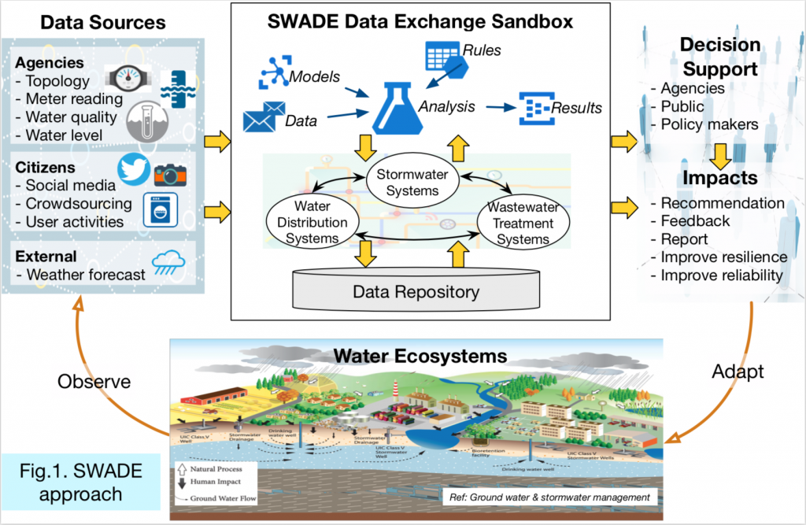
2021 Participants and Their Projects
Caleb Johnson
Project Title: Integrating IoT within Wastewater Treatment Processes
Project Description: Wastewater Treatment facilities currently do not have a safe or easy way to share data amongst themselves or with other water domains. The SWADE project aims to solve this issue and create a framework for the three water domains (wastewater, stormwater, and drinking water) to share data. The goal of this project is to integrate IoT within wastewater treatment facilities in order to improve operation and data collection within their respective treatment processes, with the aim of using this work with SWADE in the future.

Slide 3
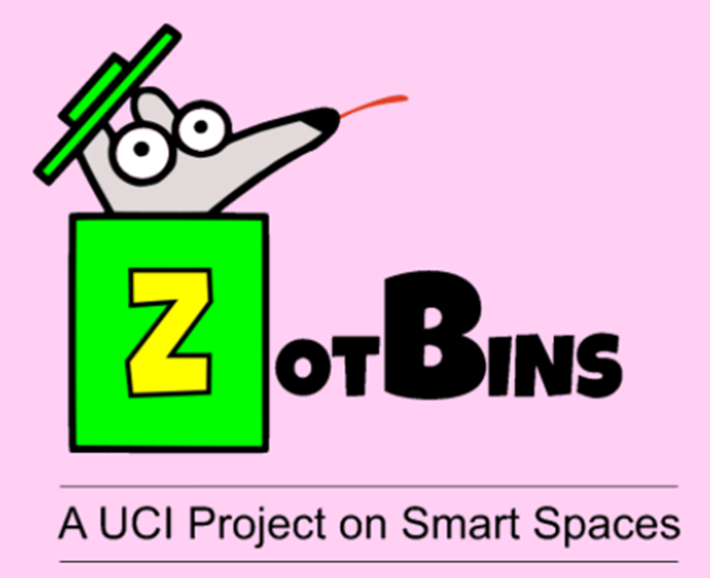
2021 Participants and Their Projects
Brianna Hernandez
Project Title: Compressed Data Collection from Sensors for ZotBins
Project Description: ZotBins is a student lead research project at the University of California, Irvine (UCI) that creates SmartBins with sensors that collect data, like pictures of the trash, fullness, and weight, to help make waste management more efficient and promote zero
waste. The purpose of this study is to find a more efficient form of communication between the SmartBins and the server to allow them to be
able to collect data on a long term basis.

Slide 4
2021 Participants and Their Projects
Isabel Rowe
Project Title: Defining Smart Spaces as JSON Objects
Project Description: Wastewater Treatment facilities currently do not have a safe or easy way to share data amongst themselves or with other water domains. The SWADE project aims to solve this issue and create a framework for the three water domains (wastewater, stormwater, and drinking water) to share data. The goal of this project is to integrate IoT within wastewater treatment facilities in order to improve operation and data collection within their respective treatment processes, with the aim of using this work with SWADE in the future.

Slide 5

2021 Participants and Their Projects
Yocelyne M Hernandez
Project Title: Context-aware Emotion Detection Framework for Improving Mental Health
Project Description: Wastewater Treatment facilities currently do not have a safe or easy way to share data amongst themselves or with other water domains. The SWADE project aims to solve this issue and create a framework for the three water domains (wastewater, stormwater, and drinking water) to share data. The goal of this project is to integrate IoT within wastewater treatment facilities in order to improve operation and data collection within their respective treatment processes, with the aim of using this work with SWADE in the future.

Slide 6
2021 Participants and Their Projects
Justin Yue
Project Title: Integrating IoT within Wastewater Treatment Processes
Project Description: Wastewater Treatment facilities currently do not have a safe or easy way to share data amongst themselves or with other water domains. The SWADE project aims to solve this issue and create a framework for the three water domains (wastewater, stormwater, and drinking water) to share data. The goal of this project is to integrate IoT within wastewater treatment facilities in order to improve operation and data collection within their respective treatment processes, with the aim of using this work with SWADE in the future.

Slide 7
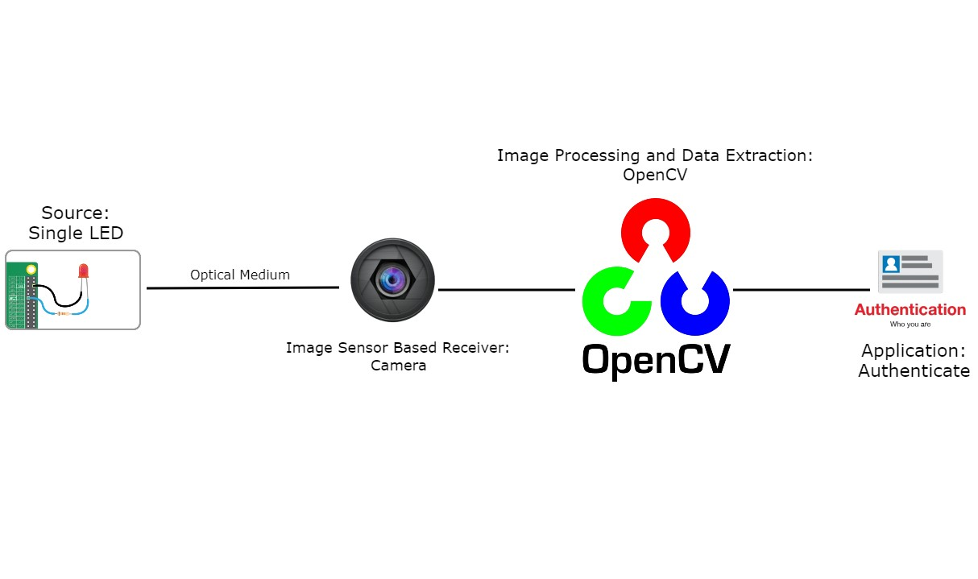
2021 Participants and Their Projects
Keirelys De Jesús Aponte
Project Title: Optical Camera Communication Testbed Using a Single Optical Channel
Project Description: In this project we are implementing Visible Light Communication, Optical Camera Communication and Computer-Vision tools to potentially send and extract data. With this we expect to create a new data send-receive system that could work as a security enhancement in the future. This is phase one, and the most important one, of a larger project.

